Slide 1
L5
POWER AMPLIFIRS

Slide 2
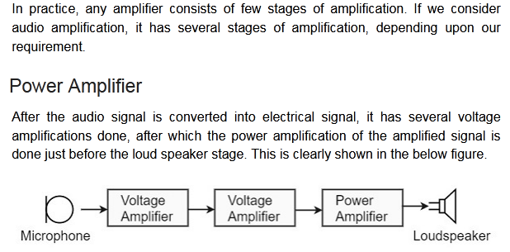

Slide 3
Classification Of Amplifiers
According to frequency capabilities.
Amplifiers are classified as audio amplifiers , radio frequency amplifiers
AF Amplifier are used to amplify the signals lying in the audio range ( i.e. 20 Hz to 20 kHz )
RF amplifiers are used to amplify signals having very high frequency.
According to coupling methods.
R-C coupled amplifiers,
Transformer coupled amplifiers
Direct Coupled

Slide 4
Classification Of Amplifiers
According to use.
Voltage amplifiers
Amplify the input voltage, if possible with minimal current at the output.
The power gain of the voltage amplifier is low.
The main application is to strengthen the signal to make it less affected by noise and attenuation.
Ideal voltage amp. have infinite input impedance & zero output impedance.
Power amplifiers
Amplify the input power, if possible with minimal change in the output voltage
Power amp. are used in devices which require a large power across the loads.
In multi stage amplifiers, power amplification is made in the final stages
Audio amplifiers and RF amplifiers use it to deliver sufficient power the load.
Servo motor controllers use power it to drive the motors.
Attenuation is a general term that refers to any reduction in the strength of a signal. Attenuation occurs with any type of signal, whether digital or analog. Sometimes called loss, attenuation is a natural consequence of signal transmission over long distances.

Slide 5
Classification Of Amplifiers
 | Voltage amplifiers | Power amplifiers
current gain | low | high
Voltage gain | high | low
Heat dissipation | low | high
cooling mechanism | not required | required
Transistor Size | Small | Large to dissipate heat
Base Width | small | Wide to handle higher current
Beta | Usually high >100 | Low usually < 20

Slide 6
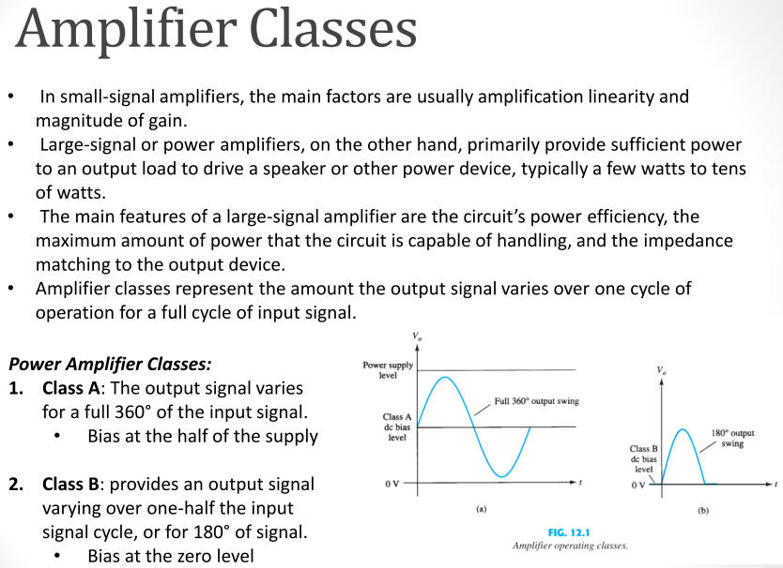
(Mode of operation)

Slide 7
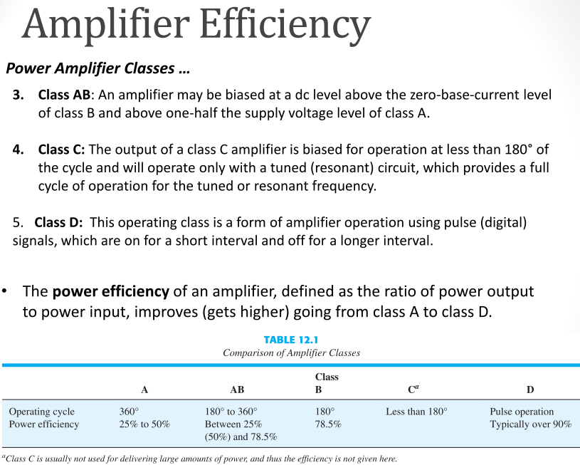

Slide 8
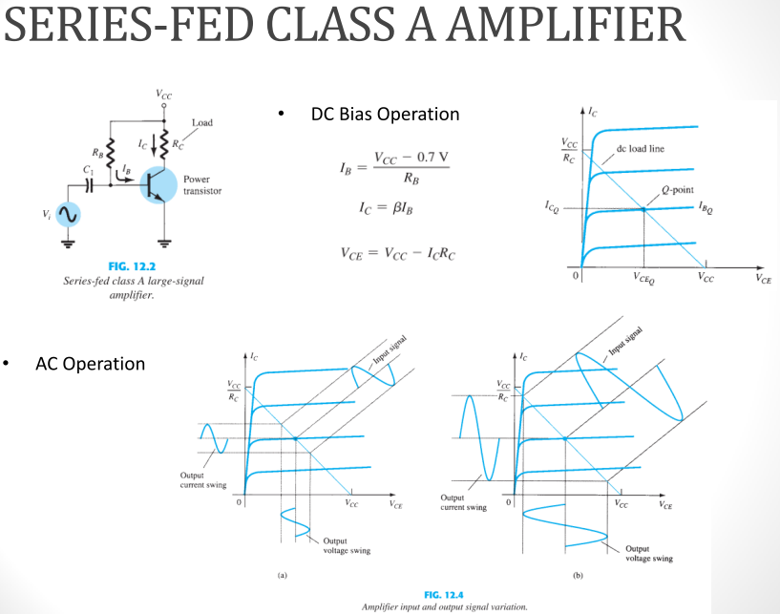

Slide 9
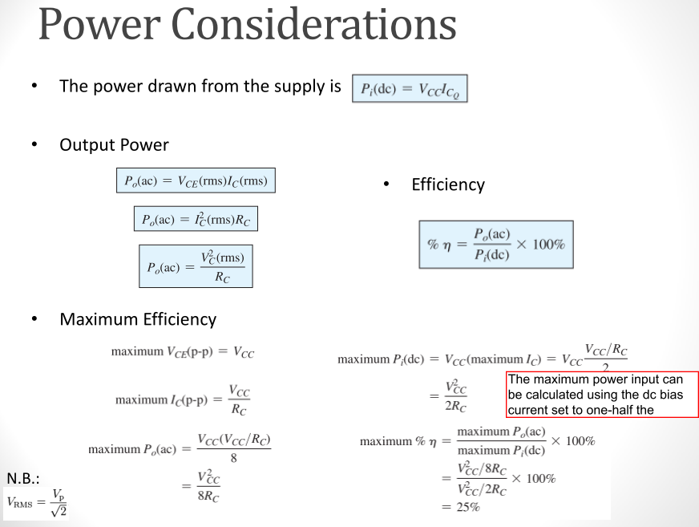

Slide 10
Class B amplifier: When an amplifier is biased at cutoff so that it operates in the linear region for 180º of the input cycle and is in cutoff for 180º
Class AB amplifiers: are biased to conduct for slightly more than 180o
Both are more efficient than a class A amplifier;
A disadvantage of class B or class AB is that it is more difficult to implement the circuit in order to get a linear reproduction of the input waveform.
The term push-pull refers to a common type of class B or class AB amplifier circuit in which two transistors are used on alternating half-cycles to reproduce the input waveform at the output.

Slide 11
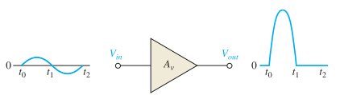
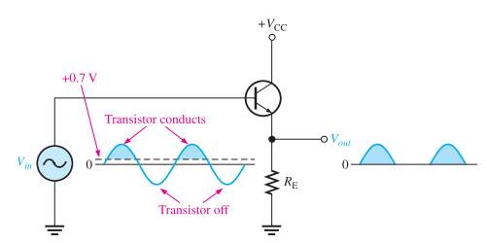
The class B amplifier is biased at the cutoff point so that
It is brought out of cutoff and operates in its linear region when the input signal drives the transistor into conduction.
The Circuit only conducts for the positive half of the cycle.
Can not amplify the entire cycle
emitter-follower circuit

Slide 12
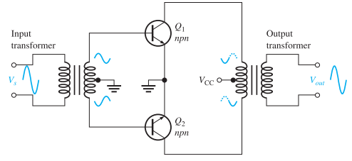
To amplify the entire cycle, it is necessary to add a second class B amplifier that operates on the negative half of the cycle.
The combination of two class B amplifiers working together is called push-pull operation
There are two common approaches for using push-pull amplifiers to reproduce the entire waveform.
Transformer Coupling
The input transformer thus converts the input signal to two out-of-phase signals for the two npn transistors.
The output transformer combines the signals by permitting current in both directions, even though one transistor is always cut off.

Slide 13
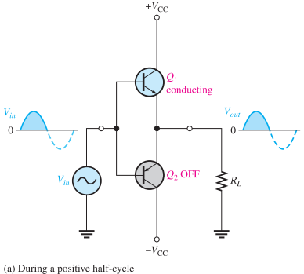
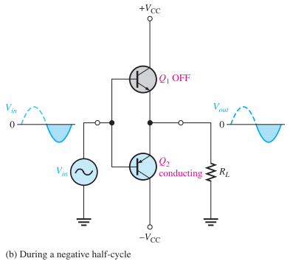
Complementary Symmetry Transistors
The figure shows one of the most popular types of push-pull class B amplifiers using two emitter-followers and both positive and negative power supplies.
This is a complementary amplifier because one emitter-follower uses an npn transistor and the other a pnp, which conduct on opposite alternations of the input cycle.

Slide 14
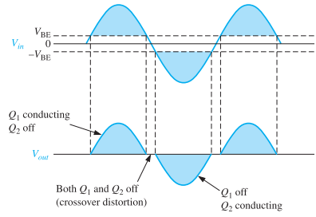
Crossover Distortion
When the dc base voltage is zero, both transistors are off and the input signal voltage must exceed VBE before a transistor conducts.
Because of this, there is a time interval between the positive and negative alternations of the input when neither transistor is conducting, as shown in Figure.
The resulting distortion in the output waveform is called crossover distortion.

Slide 15
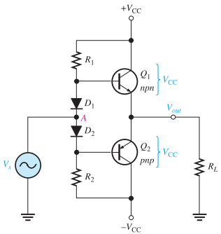

Biasing the Push-Pull Amplifier for Class AB Operation
To overcome crossover distortion, the biasing is adjusted to just overcome the VBE of the transistors
In class AB operation, the push-pull stages are biased into slight conduction, even when no input signal is present.
This can be done with a voltage-divider and diode arrangement, as shown
Using equal values of R1 and R2 the positive and negative supply voltages forces the voltage at point A to equal 0 V and eliminates the need for an input coupling capacitor.
When the diode characteristics of D1 and D2 are closely matched to the characteristics of the transistor BE junctions, the current in the diodes and the current in the transistors are the same; ((current mirror.))
The diode current will be the same as ICQ

Slide 16
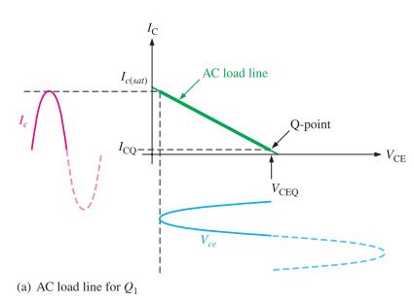


Biasing the Push-Pull Amplifier for Class AB Operation
AC Operation
The Q-point is slightly above cutoff. (In a true class B amplifier, the Q-point is at cutoff.)
The ac cutoff voltage is at VCC
The ac saturation current is:
In class A , the Q-point is near the middle and there is significant current in the transistors even with no signal.
In class B , when there is no signal, the transistors have only a very small current and therefore dissipate very little power.
Thus, the efficiency of a class B amplifier can be much higher than a class A amplifier.

Slide 17
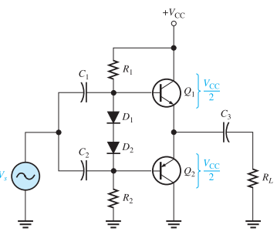


The circuit operation is the same as that described previously, except the bias is set to force the output emitter voltage to be

Slide 18







Maximum Output Power
DC Input Power
Efficiency

Slide 19

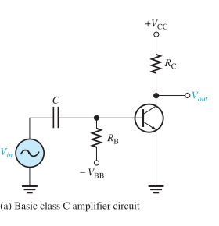
Class C amplifiers
Class C amplifiers are biased so that conduction occurs for much less than 180o
Class C amplifiers are more efficient than either class A , B, or AB
The output amplitude is a nonlinear function of the input, so class C amplifiers are not used for linear amplification.
They are generally used in radio frequency (RF) applications, including resonance circuits
Basic Class C Operation
A class C amplifier is normally operated with a resonant circuit load, so the resistive load is used only for the purpose of illustrating the concept.
The ac source voltage has a peak value that exceeds the barrier potential of the base-emitter junction for a short time near the positive peak of each cycle,

Slide 20
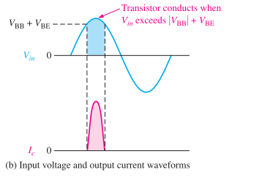
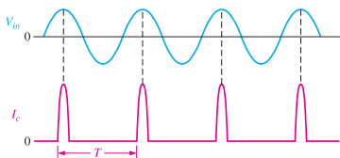

Class C amplifiers
Basic Class C Operation
During this short interval, the transistor is turned on.
The power dissipation of the transistor in a class C amplifier is low because it is on for only a small percentage of the input cycle
The power dissipation during the on time is
The power dissipation averaged over the entire cycle is

Slide 21
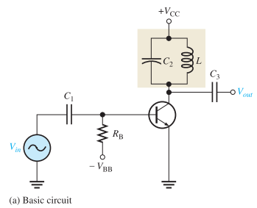
Tuned Class C Operation
Because the collector voltage (output) is not a replica of the input, the resistively loaded class C amplifier alone is of no value in linear applications.
It is therefore necessary to use a class C amplifier with a parallel resonant circuit (tank), as shown
The short pulse of collector current on each cycle of the input initiates and sustains the oscillation of the tank circuit so that an output sinusoidal voltage is produced

Slide 22
